Slide 1
Final Project
Micah Angle

Slide 2
Basic2LightFSM

Slide 3
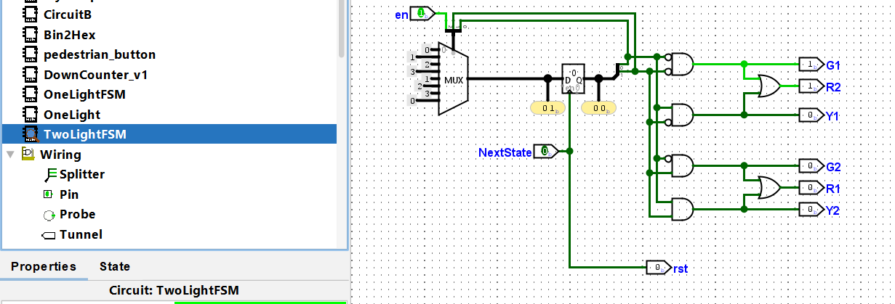

Slide 4
Basic 2 Light Main

Slide 5


